Slide 1
3D Graph Plotter
A Project in Computer Graphics

Slide 2
Graph of a function
Graph of a continuous function is a curve which arises from the set of points satisfying a specific function. The graph of a function f is the set of ordered points given by independent variables x1,x2,...,xn and a dependent variable f(x1,x2,….,xn) resulting in a continuous geometric shape as line, plane, etc. The Dimension of the graph is given by the number of independent variables required for retrieval of dependent variable in the function f.

Slide 3
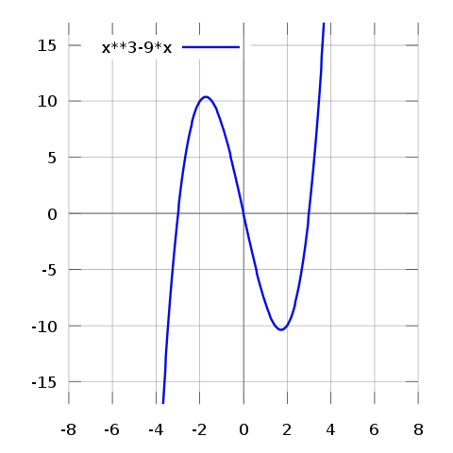
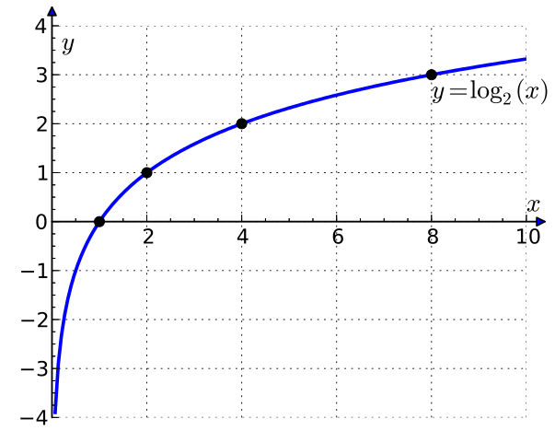
2D Graphs
A 2-Dimensional Function is represented as a mostly continuous curve in the Cartesian coordinate system. The continuous values of x and y or f(x) are plotted in vertical and horizontal axes. Thus obtained curve is two dimensional and can be easily represented in a 2D screen.
Typical 2D Graphs resemble:

Slide 4
3D Graphs
3-Dimensional Graphs are a lot different paradigms. Provided that x, y, and z or f(x, y) are real numbers, the graph can be represented as a planar or curved surface in a three-dimensional Cartesian coordinate system. A three-dimensional graph is typically drawn on a two-dimensional page or screen using perspective methods, so that one of the dimensions appears to be coming out of the page.
The information in a three-dimensional graph is collapsed into a two-dimensional graph with the use of contour lines. The x and y axes are retained, but instead of depicting a z-axis , all x, y combinations giving rise to the same z value are connected with a contour line; an arbitrary number of these may be shown for various values of z.

Slide 5
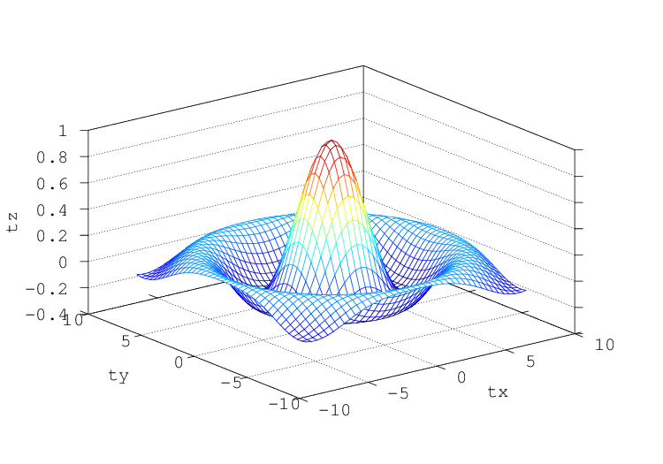
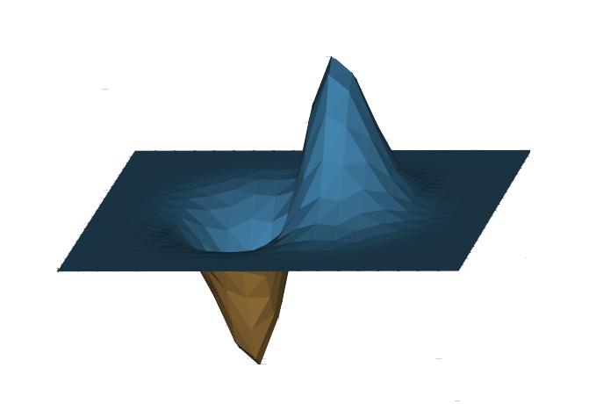
3D Graphs

Slide 6
Objectives
To draw cartesian graph of 3d functions in the form z=f(x,y).
Parsing the string input by user so that the machine interprets them as mathematical functions.
Apply basic world coordinate to device coordinate transformation using matrix and vector algebra.
Hidden surface removal using Z-Buffer algorithm.
Proper Lighting and Shading for realistic 3D effects.
Use of GLUT callback functions for user interaction.

Slide 7
Mathematical Basis

Slide 8
Matrix Library
The Matrix Library contained in the header file consists of a matrix class including a 4 dimensional array and common algebraic procedures for a matrix. The procedures include:
Constructors( zero constructor, construct with an array and copy constructor)
Algebraic Operations(addition(+), subtraction(-), multiplication(*),equation(=),comparison(==), transpose)
Debugging Operations(input, display, change)
Viewing operations(Orthographic projection, Perspective Projection, Viewport Matrix, Rotation, Translation, Scaling and Camera Matrix)
Vector manipulation( matrix*vector)

Slide 9
Vector Library
The vector library contained in the header file consists of a vector class including four vector elements(x,y,z,w) and common algebraic procedures.
The procedures include:
Constructors( null constructor, copy constructor and construction using element values)
Algebraic Operations( Addition(+), Subtraction(-), Equation(=), Comparison(==), dot product(^), cross product(*), Scalar multiplication(*), magnitude, normalize)
Normalized device Coordinate conversion(x=x/w, y=y/w, z=z/w)

Slide 10
Triangle Rasterization
Barycentric algorithm was used for triangle rasterisation which makes the use of smallest bounding rectangle as follows:
For triangle with vertices (x1,y1),(x2,y2),(x3,y3):
Xmax= max(x1,x2,x3), Xmin=min(x1,x2,x3);
Ymax=max(y1,y2,y3), Ymin=min(y1,y2,y3);
For(x=xmin;x<=xmax){
For(y=ymin;y<=ymax{
If(x,y)=Inside triangle
Plotpixel(x,y};}}

Slide 11
Z-buffer Algorithm
for(each triangle )
do{
for(each pixel(x,y) that lies in the triangle)
do{
Calculate z-depth of P at (x,y)
If (z-depth < z-buffer[x,y])
then{ z-buffer[x,y]=z-depth;
Plotpixel(x,y);
}
}

Slide 12
Miscellaneous
Flat Shading Algorithm:
V1=(x1,y1)-(x2,y2); V2=(x2,y2)-(x3,y3); V=V1*V2;
ambientLight=const
diffuseLight=normalize(V^Lightvector)
color+= ambientLight+ diffuseLight
Color interpolation:
red=(y-ymin)/(ymax-ymin);
blue=1-red;
green=0;

Slide 13
Viewing Pipeline

Slide 14
The viewing pipeline is a group of processes common from wireframe display through to near photo-realistic image generation, and is basically concerned with transforming objects to be displayed from specific viewpoint and removing surfaces that cannot be seen from this viewpoint.
The input to the viewing pipeline is a list of objects with their points defined in their own local coordinate system, and the position and orientation of the viewpoint. The output is the same list of objects with their points defined in a two dimensional screen coordinate system.

Slide 15
Local Coordinates
ModelView Matrix
World Coordinates
Projection Matrix
Eye Coordinates
Normalization with w
NDC
Viewport Matrix
Screen Coordinates

Slide 16
ModelView Matrix: This matrix performs the necessary transformation(translation,rotation,…) of the local coordinates of the and map it into world coordinates. Furthermore, it also converts the world coordinates into viewing or camera coordinates.
Projection Matrix: The perspective matrix is the very essence of 3D Computer Graphics. It does the essential job of converting 3D coordinates into presentable 2D points. It also makes the shapes bit natural looking.
Normalization: Normalization isn’t a matrix but a process of conversion of points obtained after perspective transformation back to homogeneous coordinates. This is achieved by dividing all the x, y and z coordinates by the w component. Thus obtained coordinates are in normalized device coordinates.
Viewport Matrix: Viewport matrix makes use of normalized device coordinates and convert those to the device dependent coordinates(using display screen resolution).

Slide 17
Procedure Pipeline

Slide 18
Generation of vertex array
Color Evaluation
Viewing Transformation
Vertex plotting
Wireframe Generation
Shading
Solid frame Rendering
Parsing
User Interface Actions
Hidden Surface Removal

Slide 19
Parsing: Parsing is the process of analysing a string of symbols, either in natural language or in computer languages, conforming to the rules of a formal grammar. A parser analyzes the user input equations and interpret it into machine readable language. In this project, a simple parsing library called ATMSP(A Tiny Mathematical Speed Parser) open source parsing library has been used to accomplish the work of parsing the equations. The library interprets the string equation into an expression which can later be used to calculate the corresponding value of dependent variable.
Generation of Vertex Array: The values of the vertex coordinates is calculated by defining a fine mesh of x and z coordinates. Each value for the corresponding y-component is then calculated using the values of x and z for the point in the mesh and the expression extracted earlier using the parser. The array is maintained a rectangular shape for ease of manipulation.

Slide 20
Color Evaluation: Evaluation of color for each vertex based on the graph height(y-coordinate) is done right away . Simple linear interpolation technique has been used to color the graph where the lowest value has entirely blue(#0000FF) color and the highest value has entirely red(#FF0000). Each of the points in between have a value of color in between red and blue interpolated linearly with distance.
Viewing Transformation: Viewing Transformation here corresponds to the entire viewing pipeline explained earlier. All of the vertices in the array are transformed using various matrices and Orthographic Projection giving screen Co-ordinates. Major computation time of program match to this process. The vertex values are then plotted for the initial skeletal appearance of the graph.

Slide 21
Wireframe Generation: Wireframe of the 3D graph is generated using the point plotting and lines between the points are done by Bresenham’s line drawing algorithm. Lines are drawn between each consecutive horizontal((i,j)->(i+1,j)) and vertical((I,j)->(I,j+1)) points giving a rectangular wireframe shape.
Shading: Flat shading techniques have been used here to save vital computation time and also flat shading being a standard in 3D Graphs in most of the existing graphers. Ambient and Diffuse light being the main interest to present the 2D shape a more 3D looking texture. Different reflectivity value of the graph have been experimented with and the most realistic looking was picked. The color of each vertex in association with the lighting effect gave the eventual color of the flat surface.

Slide 22
Hidden Surface Removal: Z-Buffer algorithm was used for the hidden surface removal. At first a Z-buffer array was initialized with all the pixels assigned to the maximum depth value. The depth of each pixel was calculated using the standard plane equation A*x+B*y+C*z=D and if the newly calculated depth value was less than the depth value of the pixel in the Z-buffer array, the old value was replaced by the new value in the array and the corresponding pixel was plotted.
Solidframe Rendering: All the effects of lighting,shading and hidden surface removal can be observed in the solidframe rendering model. Pressing the F2 key activates this mode. Basic rotations,zooming in and out, and panning the view can be done in this model just as in the wireframe model.

Slide 23
User Interface Actions: Various User Interface Actions were introduced for better viewing and understanding of the three-dimensional graph. The actions were handled using FreeGLUT callback functions including glutSpecialFunc() and glutKeyboardFunc(). The basic actions included the rotation around y-axis and x-axis using the arrow keys. Panning the graph around the screen using w, a, s and d keys. Toggle Wireframe and Solidfill on and off using F1 and F2 keys. Re-entering of the equation was allowed after the stroke of ‘e’ key.

Slide 24
Output
and Comparison with pre-existing Systems

Slide 25
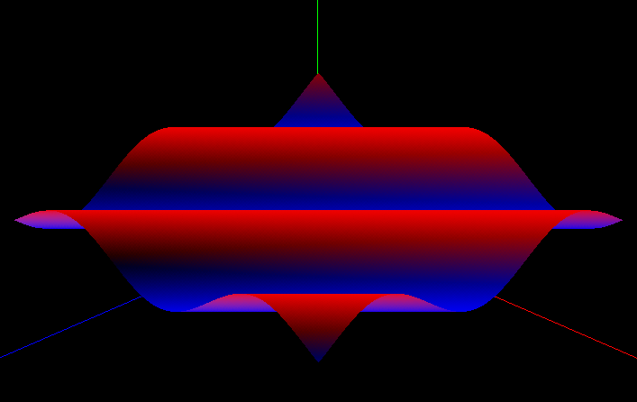
Graph Samples
Fig: Plot of sin(x+z)

Slide 26
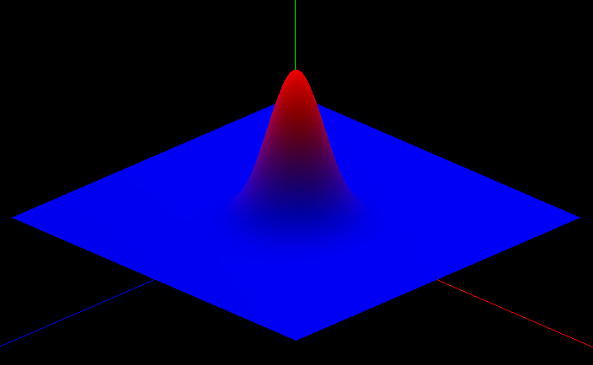
Graph Samples
Fig: Graph of exp(-x*x-z*z)*6

Slide 27
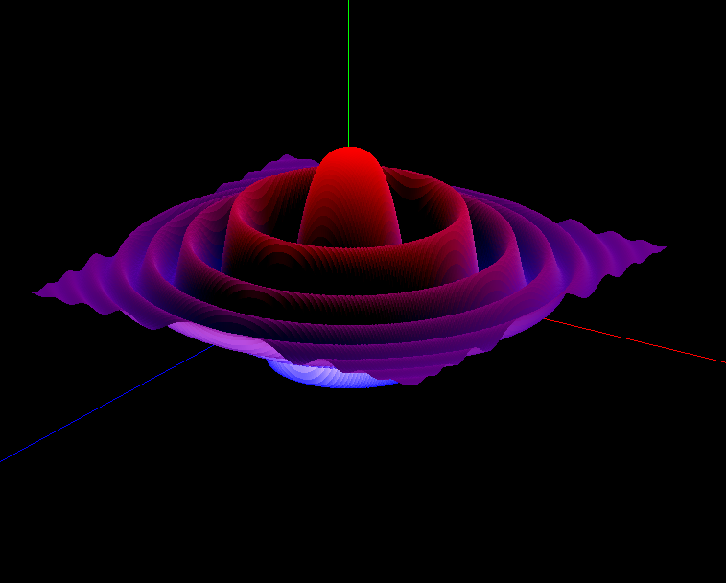
Graph Samples
Fig: Graph of exp(-x*x/10-z*z/10)*cos(x*x+z*z)

Slide 28
Problems Faced
Initially we had difficulties integrating the parsing library to our system.

Slide 29
Limitations
As the functions can only be input in the form y=f(x,z), implicit functions of the form f(x,y,z)=0 can’t be plotted.
The graph plotter is capable of plotting only the cartesian plot at the moment. Thus,Cylindrical and Spherical plot can’t be done.
Gradient difference can be visible at the edges due to flat shading of the graph. This, of course, can be solved by using other shading models like Phong or Gourard.

Slide 30
Proposed Gantt Chart

Slide 31
Actual Gantt Chart

Slide 32
Conclusion

